Slide 1
Introductie in de informatica
Wednesday 14th November 2024

Slide 2
Data Types
int (4 bytes) – Value range -2,147,483,648 to 2,147,483,647 ***the size of an integer being 4 bytes means that an integer variable typically reserves 4 bytes (or 32 bits) of memory space to store its value
char (1 byte)
double (8 byte)
boolean (1 byte)

Slide 3
Kennismaking
Naam
Achtergrond
Ervaring met programmeren?

Slide 4
Grading - Tentamen Model
Deel Tentamen(10%) + Tentamen (30%) + Project (40%)
Assignments (10%)
Class Participation (10%)

Slide 5
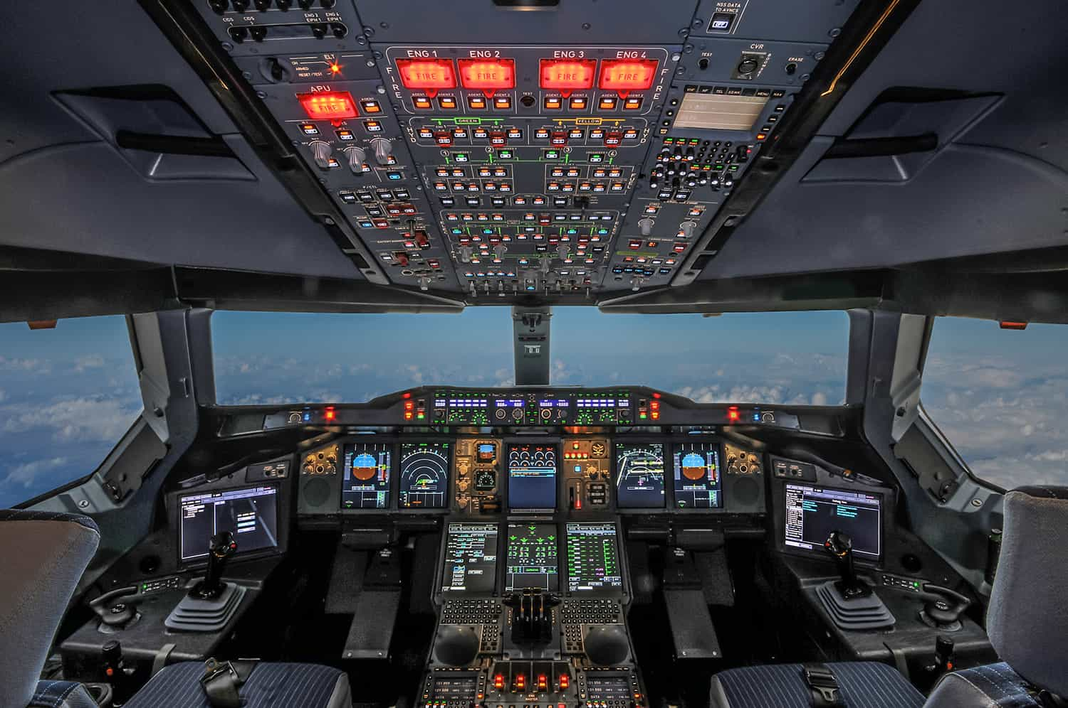
Fundamentals C++

Slide 6
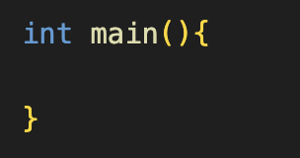
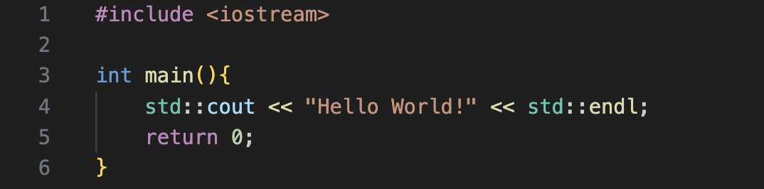
Fundamentals C++
Entry Point
Case sensitive
Structure int {” ”} main

Slide 7
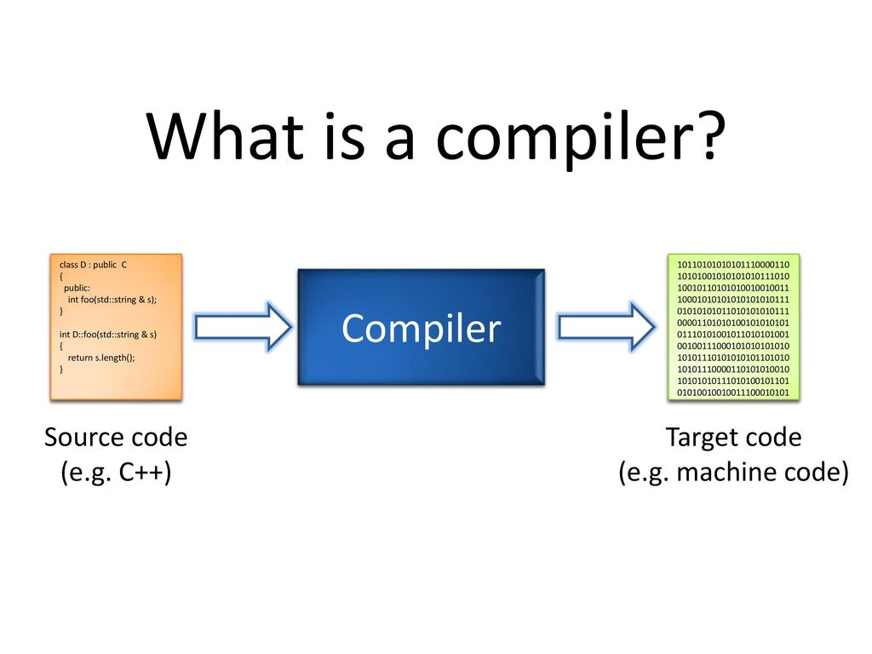
Fundamentals C++

Slide 8
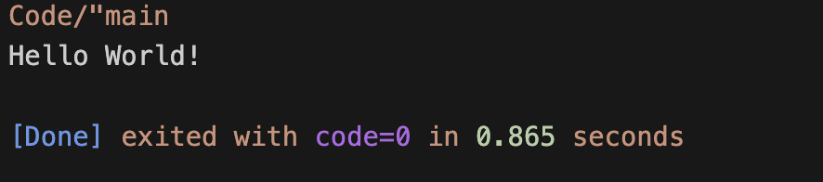
Fundamentals C++

Slide 9
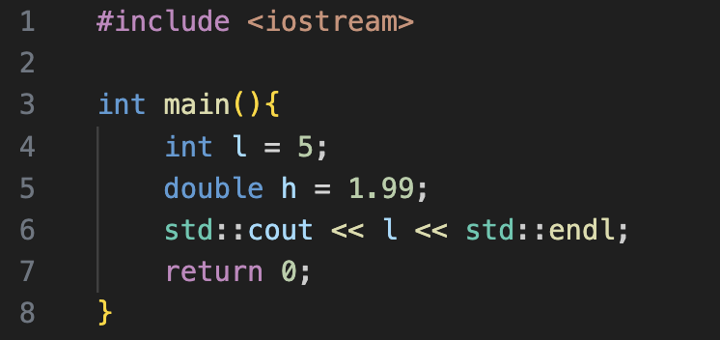

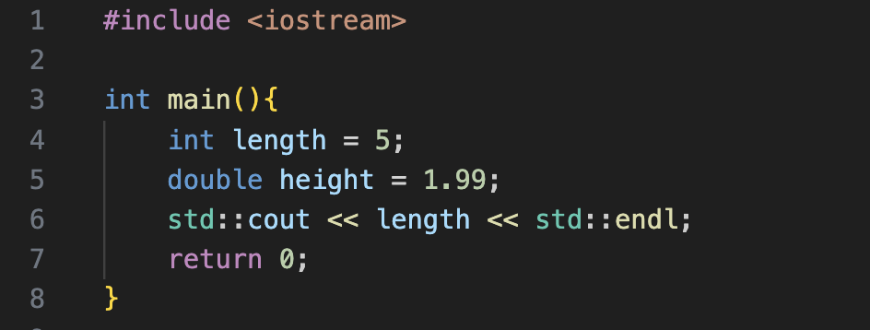

Variables

Slide 10
Opdracht
Github Registratie

Slide 11
Vragen?

